Slide 1

A PROJECT REPORT
ON
SALES ANALYSIS USING DATA ANALYTICS
Sri Krishna Devaraya University College of Engineering and Technology,
Department of Computer Science and Engineering
Anantapur - 515003
2018-2022

Slide 2
N. Raja jagadeesh chandra bose(1810164)
G. jagadeesh(1810117) k. manasa (1810119)
Project Guide:
SMT D.GOUSIYA BEGUM, MTech(PH.D.)

Slide 3
Abstract
Data is recognized as a basic form of information that needs collection, management, mining and interpretation to create knowledge. The advantages of the collection of digitalized data and build data banks has brought in great challenges of data processing for better and meaningful results according to mass data deposits. Clustering techniques therefore are necessary in sales data analysis which can have access to process data in decision making processes. This is actually defined as the sales forecasting. A sales forecast is an expression of expected sales revenue. A sales forecast estimates how much your company plans to sell within a certain time period (like quarter or year). The best sales forecasts do this with a high degree of accuracy.

Slide 4
Existing system
Finding trends within sales and discovering the most important factors affecting sales are interesting issues. A lot of methods are created to analyse sales. Furthermore, transactional data are stored in databases. This data is used by many managers to make different types of analysis, e.g., ABC, XYZ, what-if analysis, top 10 customers and top 10 items.

Slide 5
Proposed system
The purpose of sales analysis using Data Analytics is to present some basic ideas on sales analysis that support the process of determining the minimum stock and profit margin by grouping items into categories “Fast moving” and “Slow moving” and “Dead Stock” of the sale using Data analysis tools.. The main aim of the sales analysis to reason and illustrate the rectangle method for sales analysis. The illustration is done with a sample dataset. The core of the rectangle method is to find product items that may be offered to shops which have not ordered them. The practical implications of this paper concern other practitioners. They may use the rectangle method as an additional one to other frequently used sales analysis methods.

Slide 6
Data Analysis
Data analysis is a process of inspecting, cleansing, transforming, and modelling data with the goal of discovering useful information, informing conclusions, and supporting decision-making.
In today's business world, data analysis plays a role in making decisions more scientific and helping businesses operate more effectively.
Types of Data Analysis:
Descriptive Analysis (What Happened)
Diagnostic Analysis (Why it is Happened)
Predictive Analysis (What is likely to happen)
Prescriptive Analysis (Combining insights from all previous analyses)

Slide 7
Data mining
Data mining is a particular data analysis technique that focuses on statistical modelling and knowledge discovery for predictive rather than purely descriptive purposes, while business intelligence covers data analysis that relies heavily on aggregation, focusing mainly on business information.
Stages of Data Mining:
Data sources
Data Warehousing
Extract, Transform and Load (ETL)
Model Planning, Building
Data Visualization
Decision Making

Slide 8
Hardware & software requirements
Hardware Requirements
Processor: I5 or above 8th gen
Ram: 4gb
GPU: Gt 1030 ti
Hard Disk: 10gb

Slide 9
Software Requirements:
POWER BI – This is a Business Intelligence Tool
MySQL – Data source that is used in this project
SQL – Programming Language for Querying the Data in a Relational Database
DAX – Data Analysis Expressions is a language that is used for evaluation of data for data Transformation in the Data processing tools such as POWER BI, EXCEL.

Slide 10
Tool used in sales Data analysis
Power BI is a collection of software services, apps, and connectors that work together to turn your unrelated sources of data into coherent, visually immersive, and interactive insights. Your data may be an Excel spreadsheet, or a collection of cloud-based and on-premises hybrid data warehouses. Power BI lets you easily connect to your data sources, visualize and discover what's important, and share that with anyone or everyone you want.
With Power BI Desktop, we can:
Connect securely to hundreds of data sources —in the cloud and on-premises
Transform and mash up data from multiple sources—in just a few clicks
Extend your data models with DAX formulas
Choose from more than 100 cutting-edge data visuals—or create your own
Dig deep into data to find patterns and discover insights
Build out your design with intuitive formatting tools and themes
Share visual analytics with everyone in your organization

Slide 11
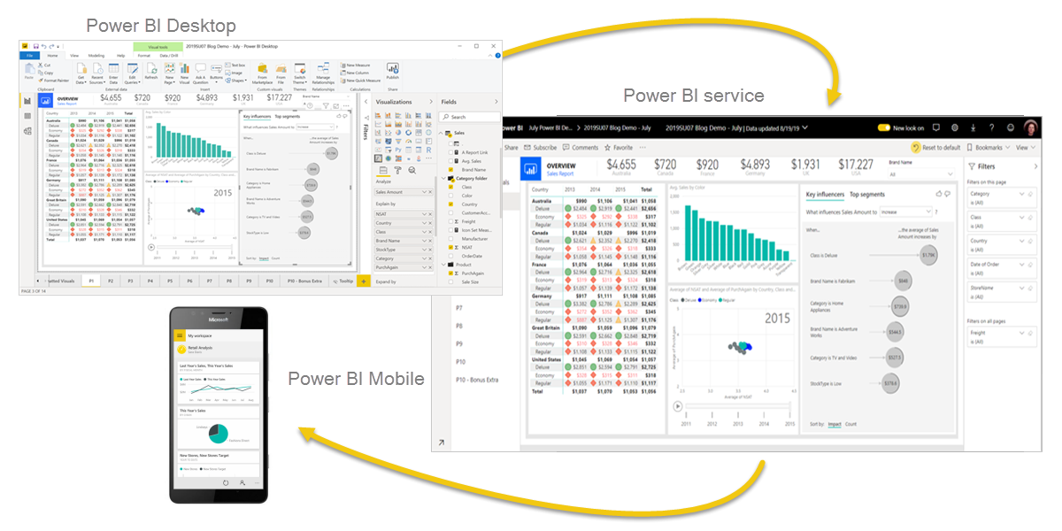
POWER BI desktop

Slide 12
1. Data Sources
A data source is the location where data that is being used originates from. A data source may be the initial location where data is born or where physical information is first digitized, however even the most refined data may serve as a source, as long as another process accesses and utilizes it.
Types of Data Sources:
File
Data Base
Cloud Services
Online Sources
Other

Slide 13
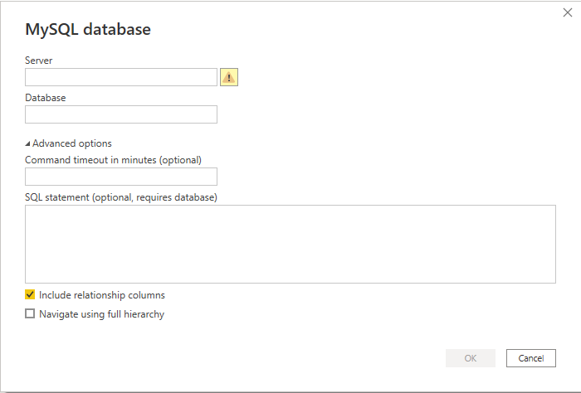
Data collection from MySQL DATABASE SOURCE

Slide 14
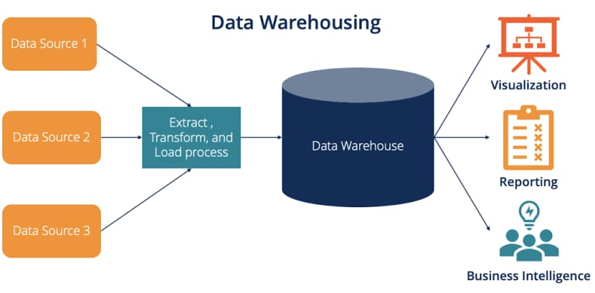
2. Data warehousing
Data warehousing is a process used to collect and manage data from multiple sources into a centralized repository to drive actionable business insights. With all your data in one place, it becomes simpler to perform analysis and reporting at different aggregate levels.

Slide 15
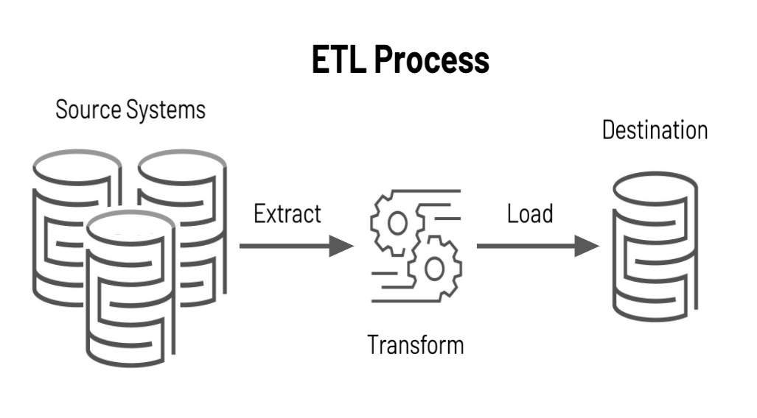
3. Extract, Transform and load
ETL, which stands for extract, transform and load, is a data integration process that combines data from multiple data sources into a single, consistent data store that is loaded into a data warehouse or other target system.

Slide 16
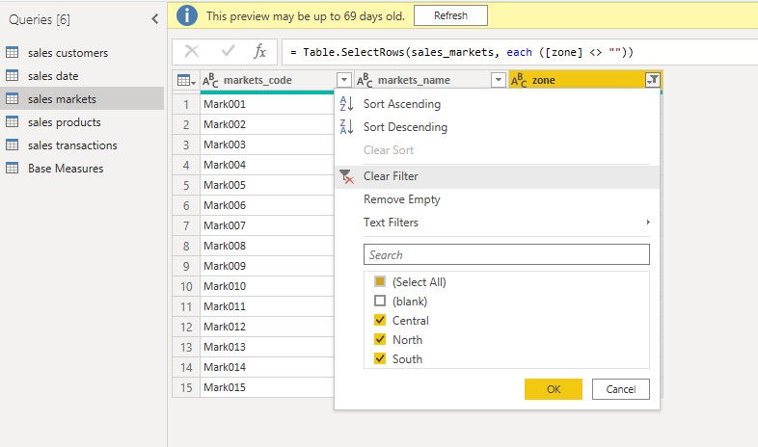
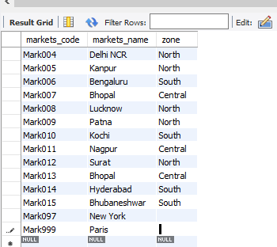

Slide 17
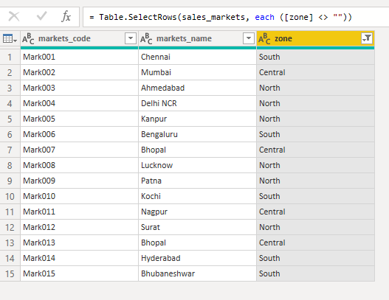

Slide 18
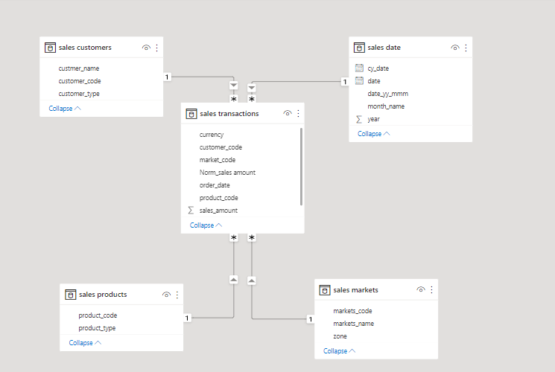
4. Model planning and building
This is a phase where you have to analyze the quality of data and find a suitable model for your project.
Types of Models:
Star Schema
Snowflake Schema
Galaxy Schema

Slide 19
5. Data visualization
Data visualization is the graphical representation of information and data. By using visual elements like charts, graphs, and maps, data visualization tools provide an accessible way to see and understand trends, outliers, and patterns in data.
Types of Visualization Techniques:
Charts
Tables
Graphs
Maps
Infographics
Dashboards

Slide 20
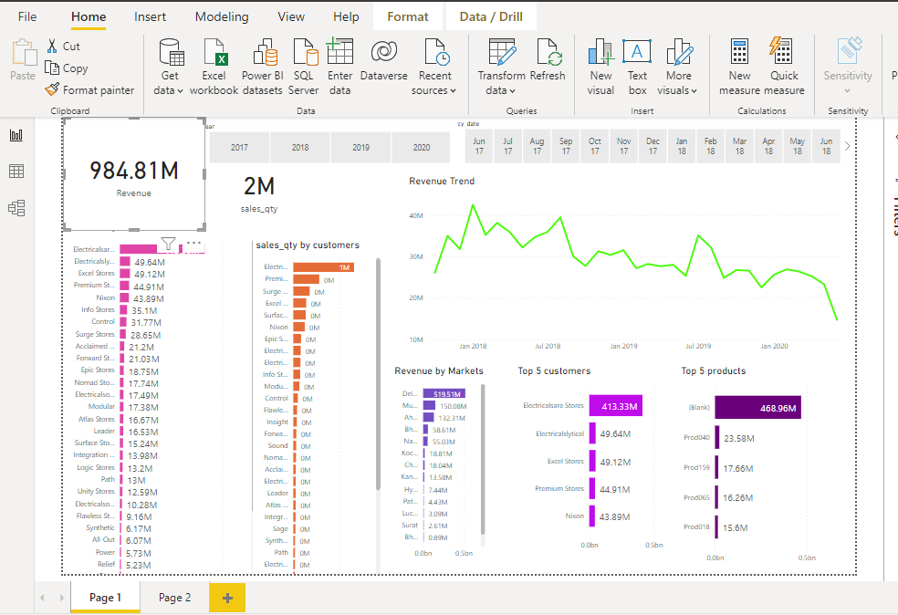
Data Visualization

Slide 21
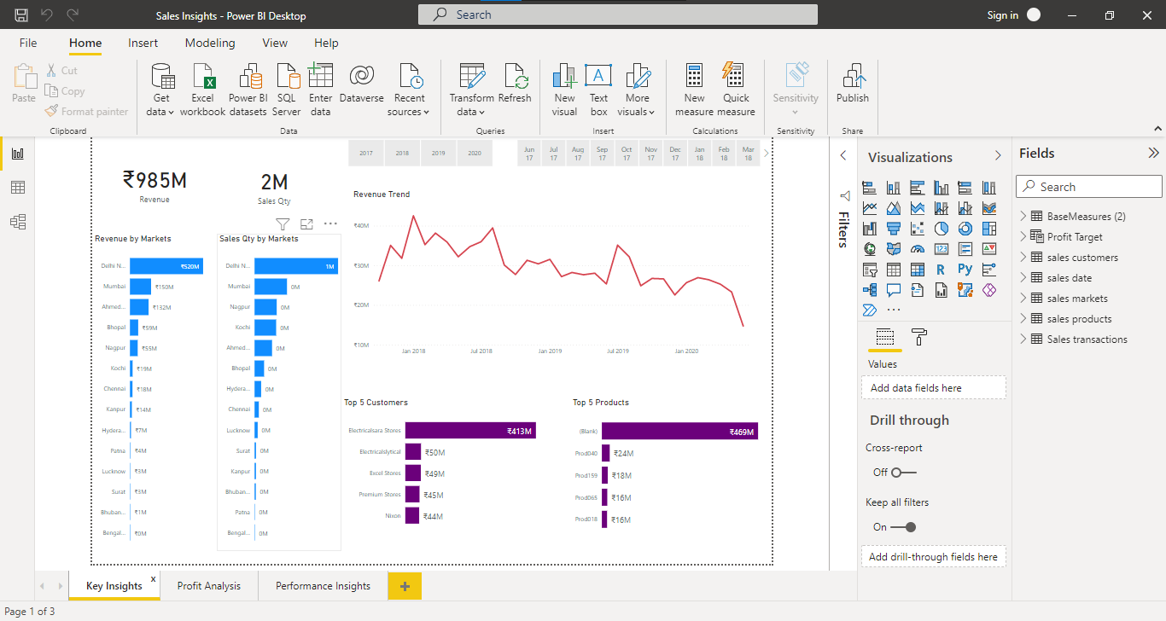
Data visualization reports on key insights

Slide 22
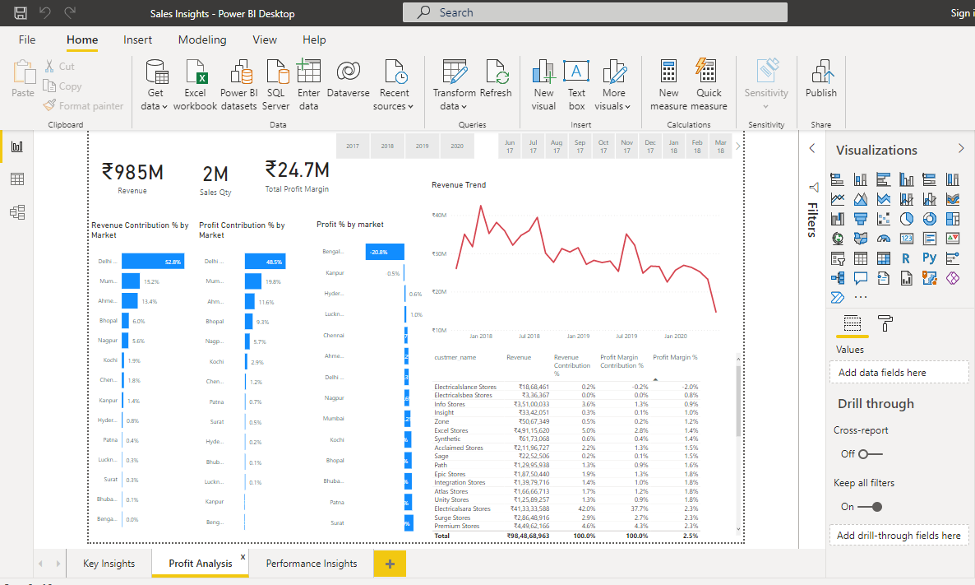
Data visualization reports on profit analysis

Slide 23
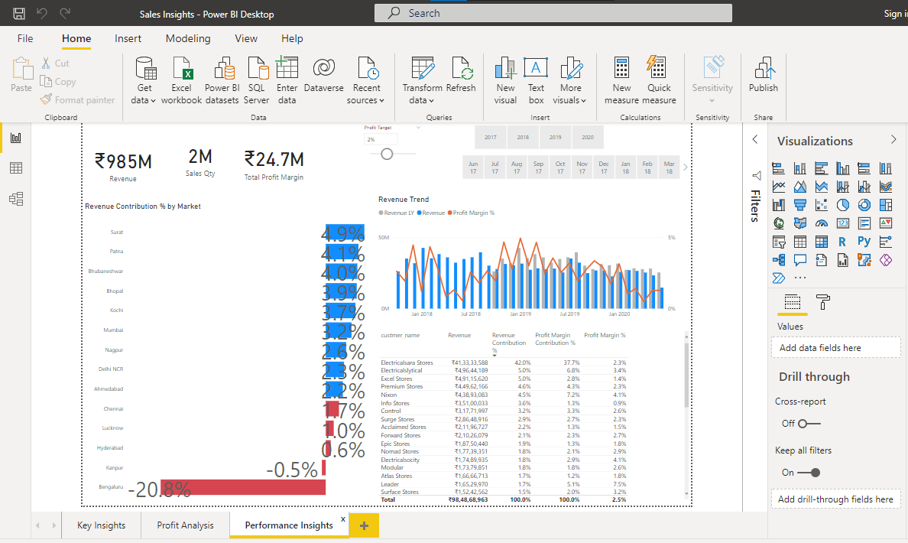
Data visualization reports on performance insights

Slide 24
Decision making
B2B organizations should be highly involved in their sales decision-making process. And to do that, they must learn how to leverage sales data properly. But, why do sales data even matter?
Let us help you out here:
1. Discover your ideal customers
Your ideal customer is any individual who intends to buy your products and services. But the question is how do you discover the individuals who have sufficient purchase intent and are willing to purchase from you? That’s where the concept of sales data comes into the picture.
2. Expedite your prospecting process
One of the major activities of any sales rep is reaching out to more prospects through cold calls, social selling, and emails. But it will be a complete waste of time for them if they don’t have proper sales data.
3. Ensure sales process optimization
Sales managers are always seeking new ways to improve their sales team’s performance. But how are they supposed to do that if they don’t have actionable insights?

Slide 25
Ways to achieve sales data growth
  1. Identify new lead generation options
High-quality sales data can be a major source of new lead generation for your sales team. Once you have successfully collected the sales data from authentic sources, you can use a sales analytics tool like Salesmen to discover the purchase intent of the prospects. Such a tool can help you with lead scoring. That way, reps will understand which prospect is most likely to convert into customers and can direct their efforts accordingly.
  2. Don’t chase prospects with low purchase intent
Not all customers will fit the criteria of your buyer persona. In B2B selling, reps should always focus on converting leads who are a good fit. B2B lead generation process involves high costs, energy, and a lot of valuable time. You can’t risk your conversion process by targeting bad-fit prospects as it will delay your whole lead generation process.
  3. Nurture and build relationships with leads and customers
High-quality sales data not only help you identify the proper leads but also helps you nurture them with suitable strategies and approaches.

Slide 26
  4. Experiment and improve your communication process
Trial and error is the secret to a successful sales or marketing campaign, so what’s better than a regular trial and error process? A data-driven one. So, use the collected sales data to experiment and apply the results to modify your marketing strategy.
Try different ways of communication with your prospects. From email outreach to social media outreach, try it all. Also, don’t stop at the experiments. Analyse the results and build your sales strategy accordingly.
5. Track your sales team’s performance regularly
Use a sales enablement tool like Salesmen to track your sales team’s performance regularly. Here’s how it can help:
With cutting-edge conversational analytics, Sales Ken can analyse your reps’ conversations with prospects.
It can help offer in-depth insights on the prospect’s purchase intent and highlight improvement areas in the sales pitch.
Sales Ken can further provide sales coaching to the reps. That way they can work on their individual strengths and weaknesses and perfect their sales pitches.
6. Master the decision-making process
Use consistent sales data to support your sales decision-making process. Updated sales datasets can predict future sales patterns for your team and drive more lead generation opportunities.

Slide 27
Advantages
Determine the Most Profitable Products (and make them shine)
Find the Slow-Moving Products (and focus your resources more effectively)
Pinpoint the Most Profitable Customers (and keep them coming back for more)
Identify Sales Opportunities (and potential problems)
Consolidate All Business Intelligence (and use it to make data-backed decisions)

Slide 28
Conclusion and Future work
FUTURE SCOPE
Data scientists are experts in the use of software, like Java, Hadoop, Python, and Pig. Their chores include business exploration, structuring analytics, and data management. The main reason for Data Science's future getting bright is its high-end demand because of digitalization.

Slide 29
CONCLUSION
Now that you have analyzed your data, the last step is to draw your conclusions. Conclusions summarize whether the experiment or survey results support or contradict the original hypothesis. Teams should include key facts from your team's background research to help explain the results.

Slide 30
THANK YOU☺

